Slide 1
Bài 2.
Native VLAN, EtherChannel

Slide 2
Contents
Native VLAN
EtherChannel

Slide 3
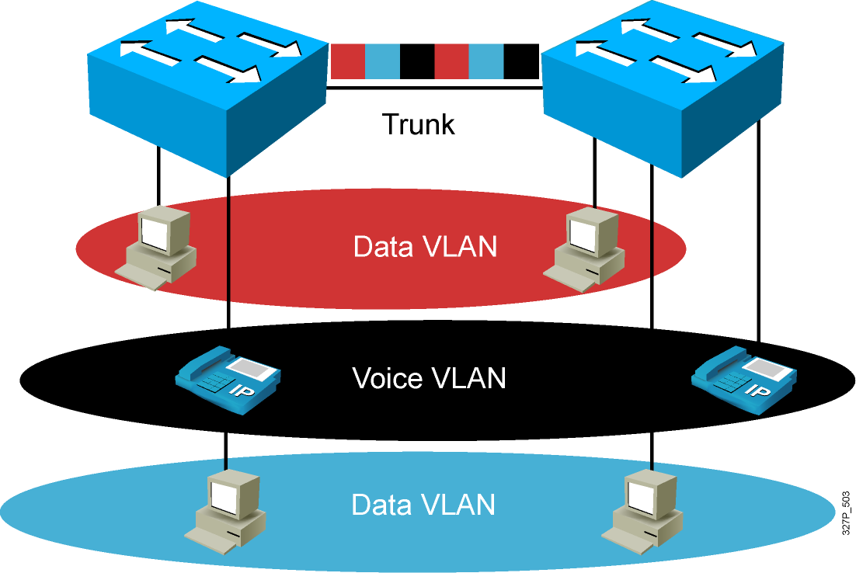
Native VLAN
Native VLAN is a concept in networking, primarily used in 802.1Q trunking.
It is the VLAN to which untagged traffic is assigned when it traverses a trunk port.

Slide 4
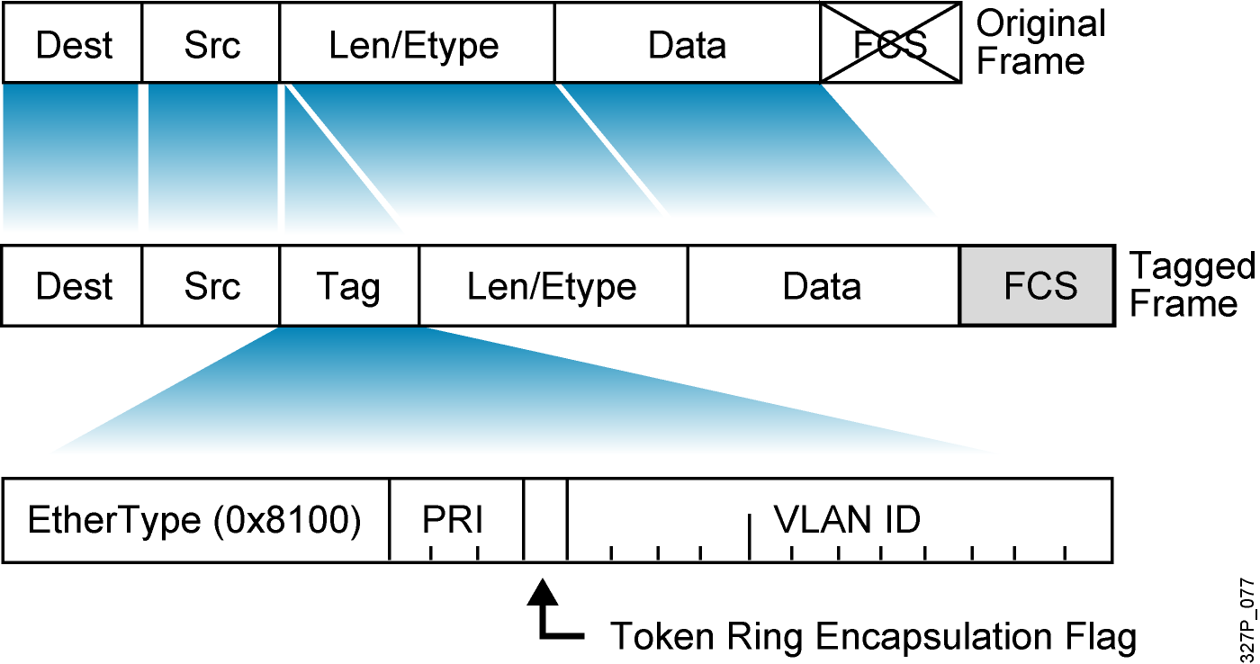
802.1Q Frame

Slide 5
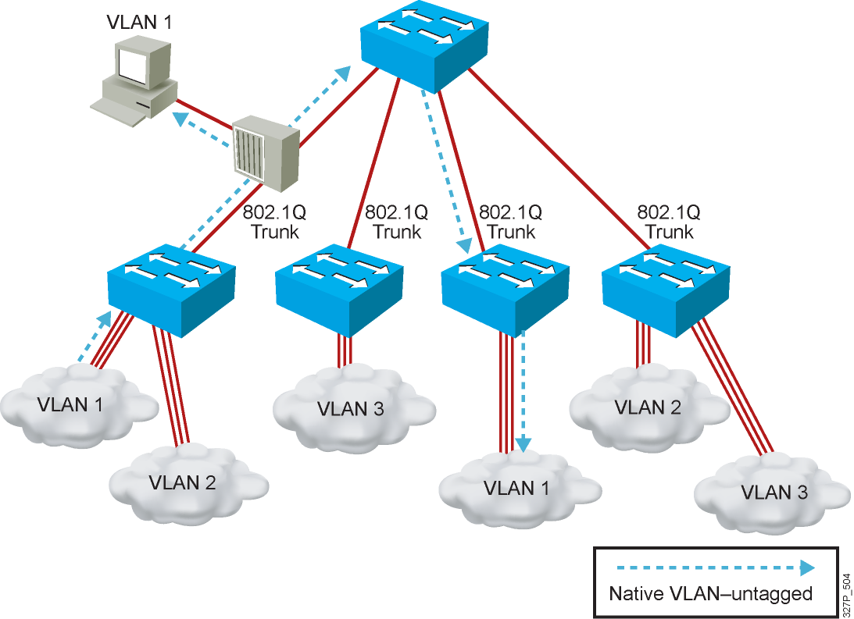
Understanding Native VLANs

Slide 6
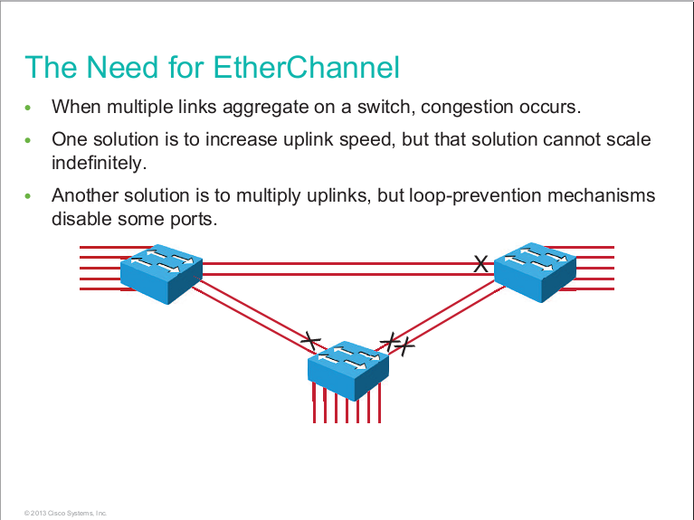

Slide 7
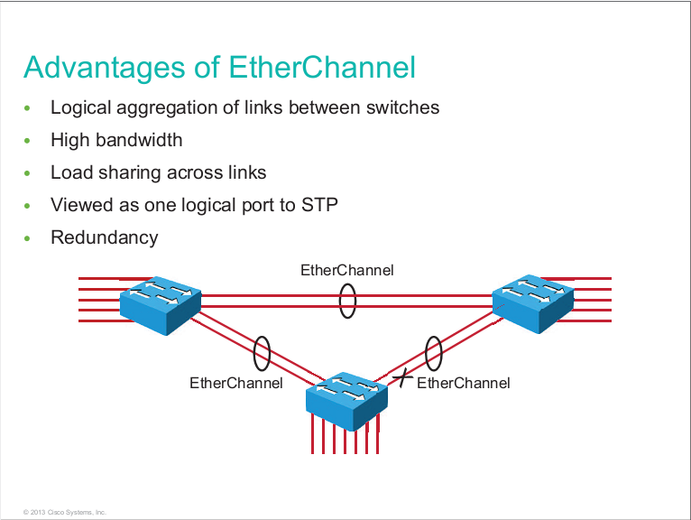

Slide 8
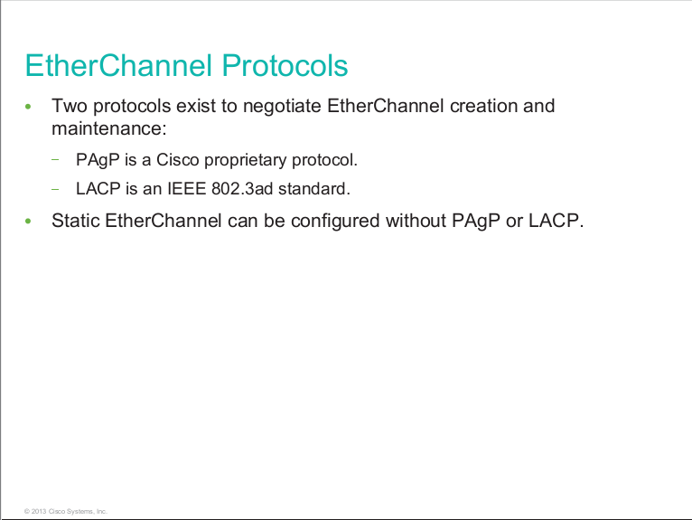

Slide 9
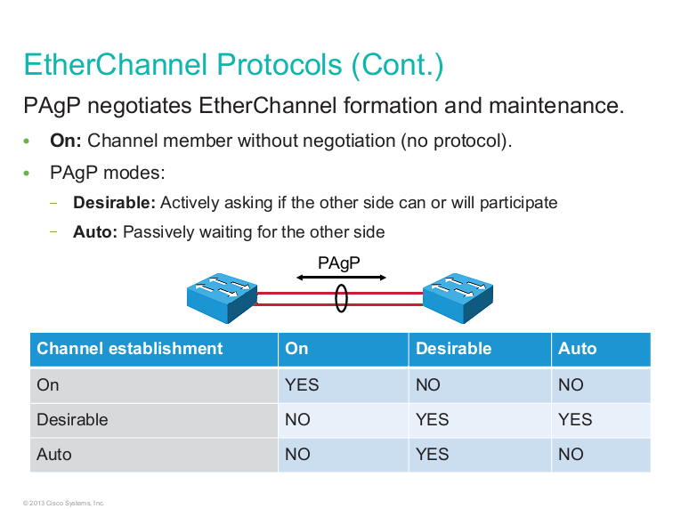

Slide 10
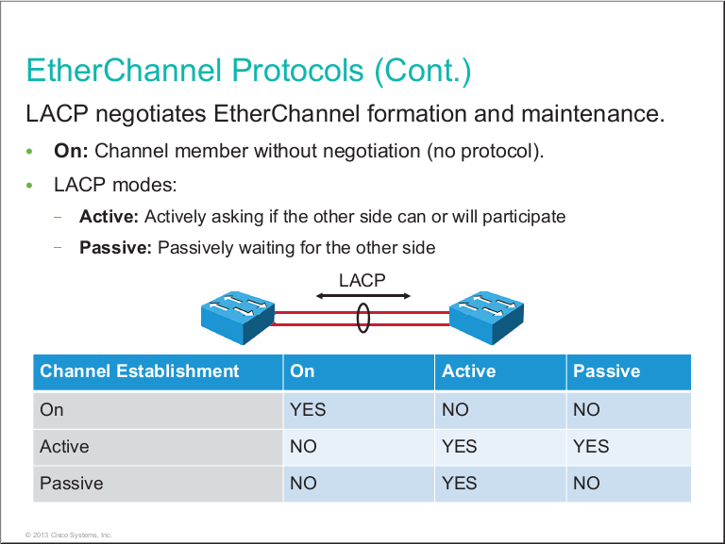

Slide 11
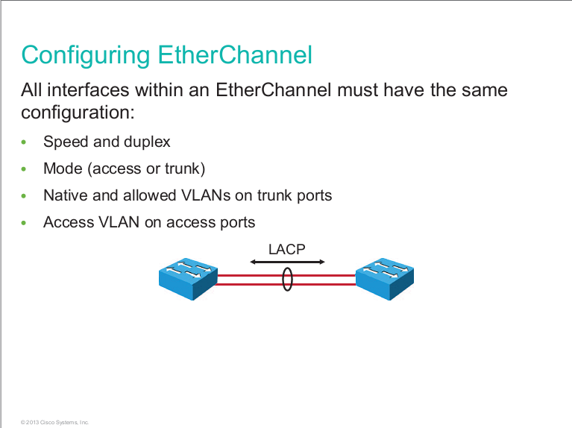

Slide 12
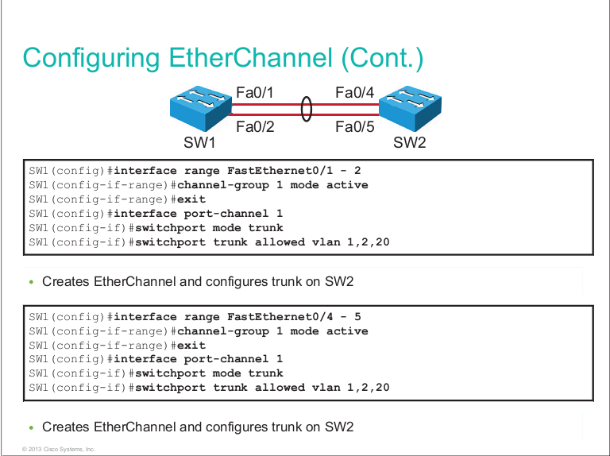

Slide 13
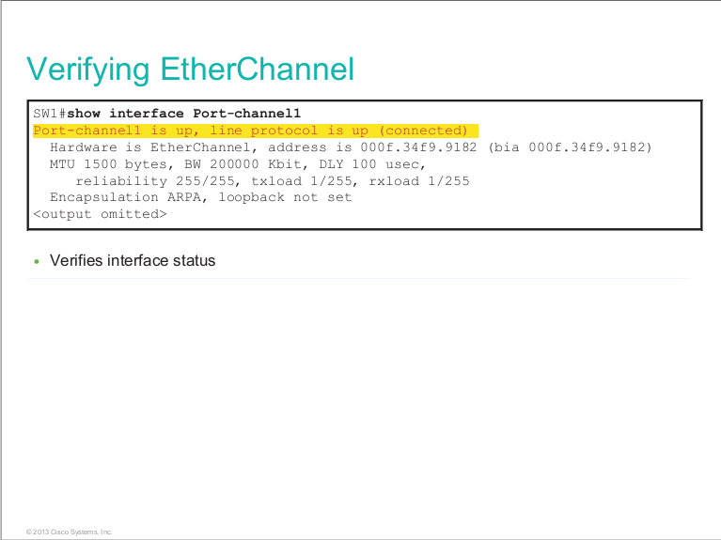

Slide 14
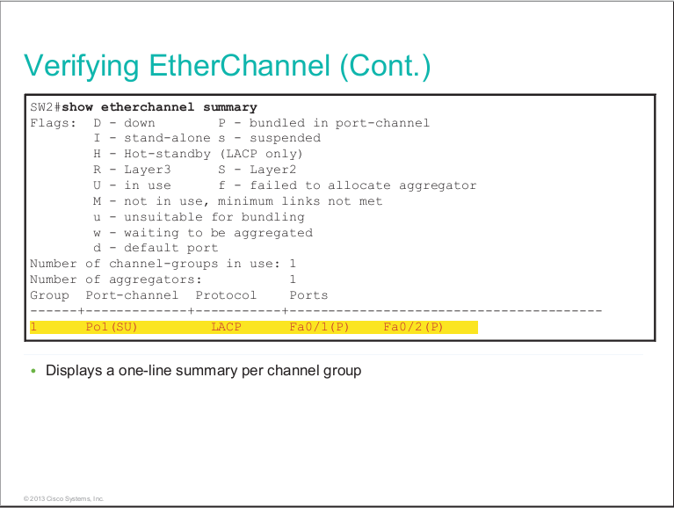

Slide 15
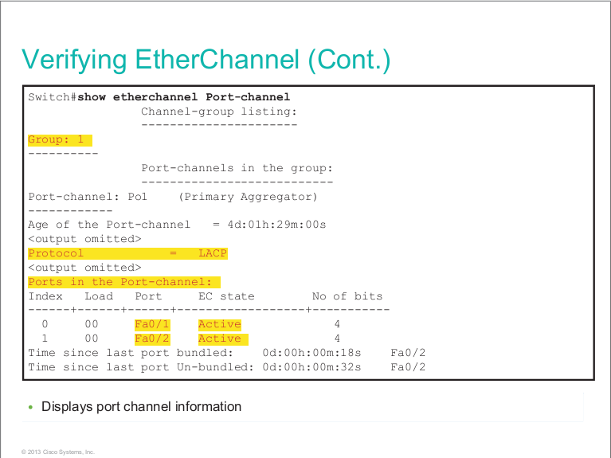

Slide 16
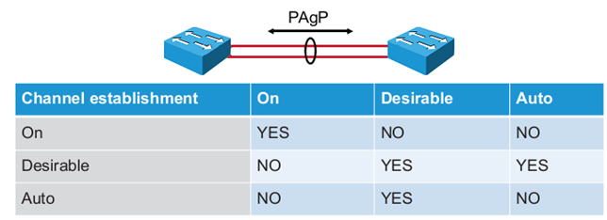
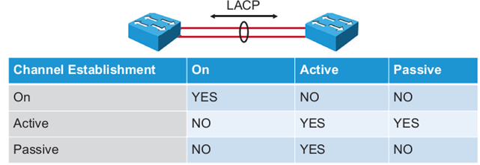
Lab: EtherChannel
Giao thức: PAgP (Cisco), LACP (IEEE 802.3ad)
Etherchannel Layer 2
EtherChannel Layer 3

Slide 17
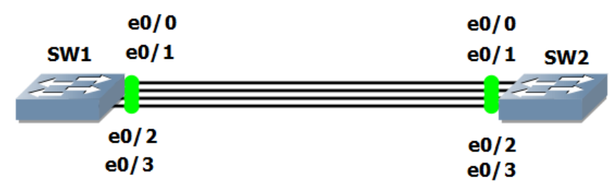
HD cấu hình:
SW1(config)#interface range e0/0 – 3
SW1(config-if-range)#channel-protocol pagp
SW1(config-if-range)#channel-group 10 mode desirable
SW#show etherchannel summary

Slide 18
Cấu hình Portchannel 10 là port Trunk
SW1(config)#interface port-channel 10
SW1(config-if)#switchport trunk encapsulation dot1q
SW1(config-if)#switchport mode trunk
SW1(config-if)#exit
SW2(config)#interface port-channel 10
SW2(config-if)#switchport trunk encapsulation dot1q
SW2(config-if)#switchport mode trunk
SW2(config-if)#exit
SW#show interfaces trunk

Slide 19
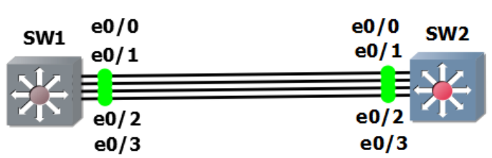
Layer 3 EtherChannel
SW1(config)#interface range e0/0 – 3
SW1(config-if-range)#channel-protocol pagp
SW1(config-if-range)#channel-group 10 mode desirable
SW1(config)#interface port-channel 10
SW1(config-if)#no switchport
SW1(config-if)#ip address 1.1.1.1 255.0.0.0
SW2(config)#interface range e0/0 – 3
SW2(config-if-range)#channel-protocol pagp
SW2(config-if-range)#channel-group 10 mode desirable
SW2(config-if-range)#exit
SW2(config)#interface port-channel 10
SW2(config-if)#no switchport
SW2(config-if)#ip address 1.1.1.2 255.0.0.0
SW#show interfaces port-channel 10

Slide 20
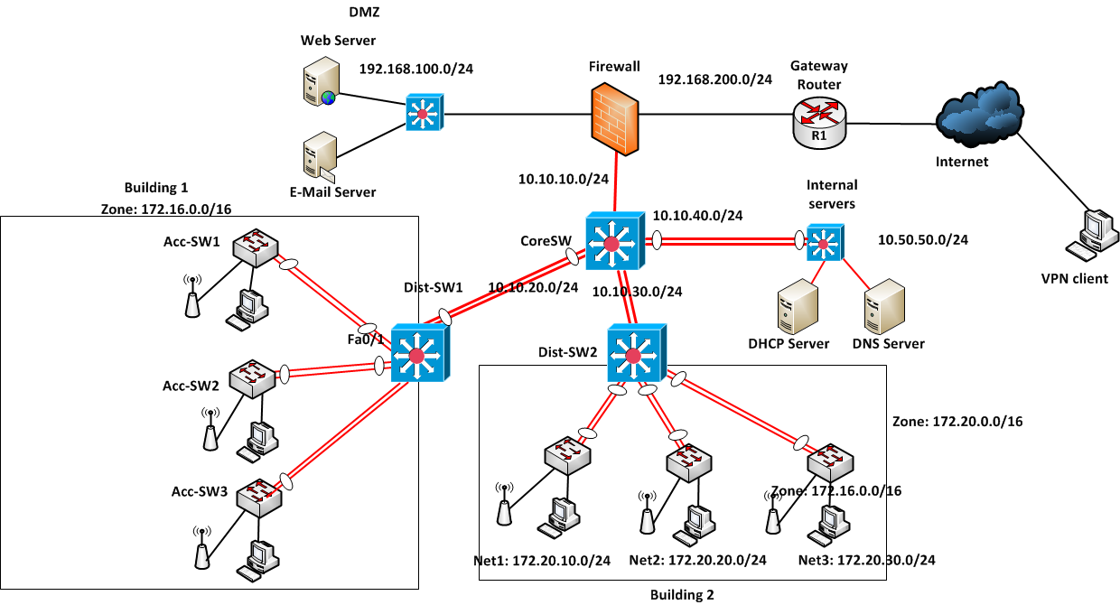
Lab: EtherChannel

Slide 21
